Slide 1
Human Induced Earthquakes: Causes and Effects
By : Meenakshi Nadimuthu

Slide 2
Motivation to choose this topic?
Californians are no strangers to Earthquakes
Advanced technologies and seismic instruments record more earthquakes in the recent years.
We wanted to investigate the Human Induced earthquake causes and its influence on global earthquake data.

Slide 3
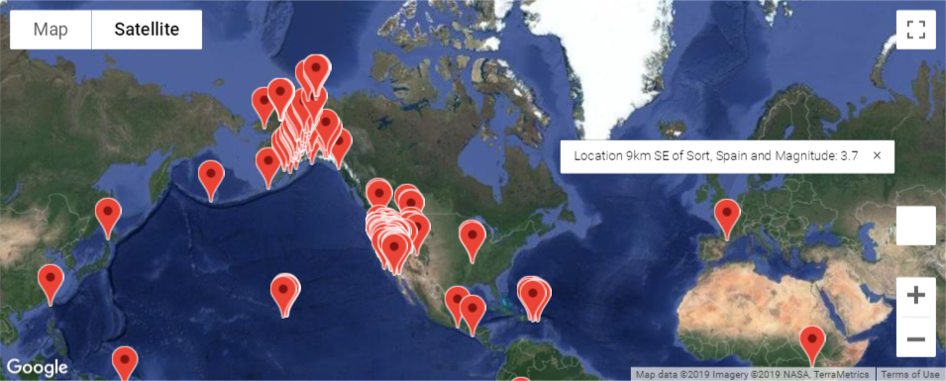
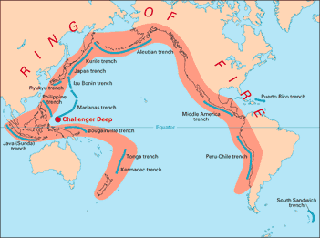
Visualization of Earthquakes occurred in the past day
Earthquakes occurred in the past day
gmap (marker_layer)

Slide 4
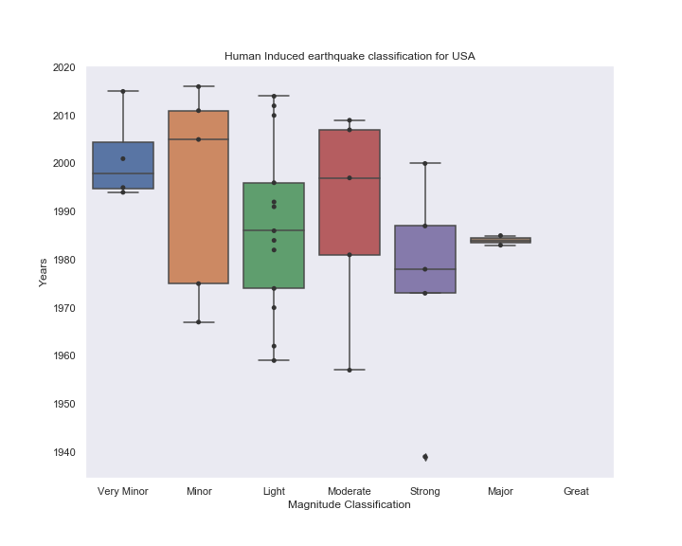
Based on the data, the number of HI earthquakes in USA has increased over the years.
Majority of observed HIQuakes fall under Minor to Moderate magnitude category.
Occurrences of HIQuakes in US
Seaborn library - Boxplot and Swarmplot

Slide 5
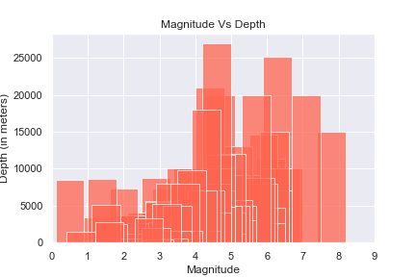
Is there a link between Depth and the Magnitude of the earthquake?
Magnitude Vs Depth
Based on my analysis, there are lot of low magnitude earthquakes that had occurred in low depths.
A study mention, Lower magnitude shallow earthquakes can cause more damages, than a higher magnitude deep earthquakes.
Matplotlib - Bar Chart

Slide 6
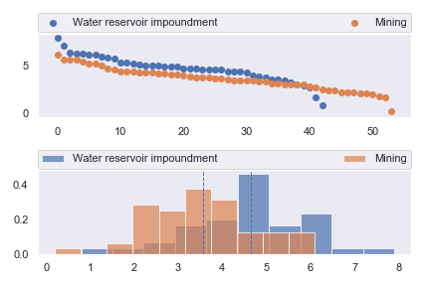
Statistics Analysis- Top 2 Causes and Magnitude
Hypothesis :
The magnitudes of HIQuakes caused by Mining is significantly different from magnitudes of HIQuakes caused by Water Reservoir Impoundment
Null Hypothesis:
The magnitudes of HIQuakes caused by Mining is NOT significantly different from magnitudes of HIQuakes caused by Water Reservoir Impoundment
Ttest_indResult
(statistic=4.154549887965083, pvalue=7.793388460472081e-05)

